Slide 1
Chongqing University of Technology
ATAI
Advanced Technique of Artificial Intelligence
Chongqing University of Technology
Label-Wise Document Pre-Training for Multi-Label Text Classification（NLPCC 2020 CCF C类）
彭展望
代码：https://github.com/laddie132/LW-PT

Slide 2
Outline
Introduction
Related Work
Method
Experiment
Conclusion

Slide 3
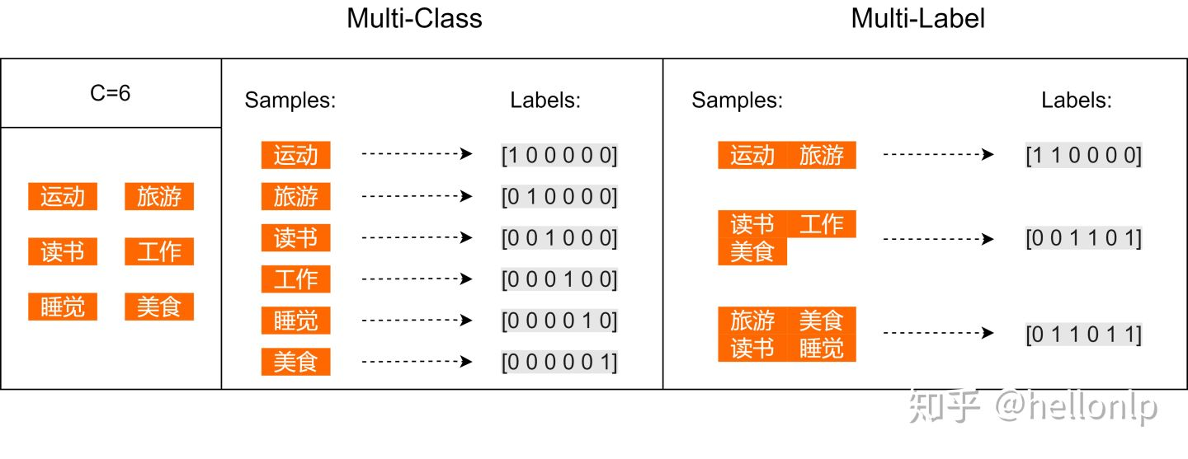
Introduction

Slide 4
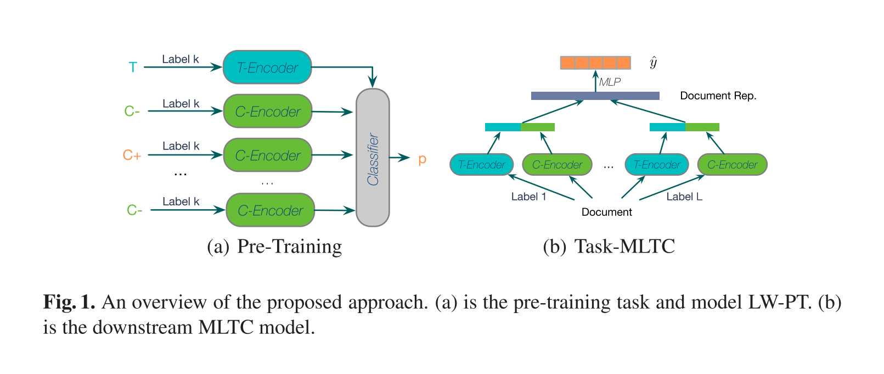
Method

Slide 5
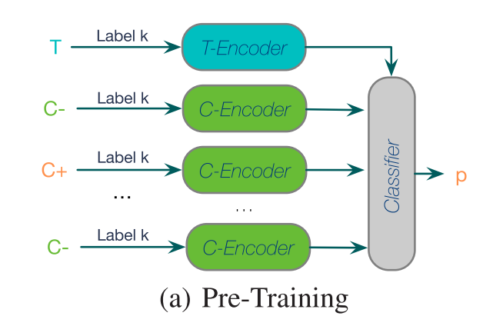
a positive example $C^{+}$ which has the same label k
several negative examples $C^{+}$ which doesn’t have the label k

Slide 6
Method
LW-LSTM:

Slide 7
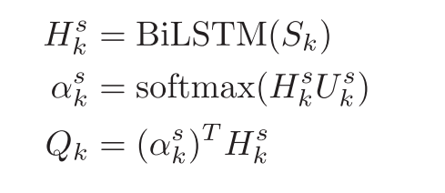
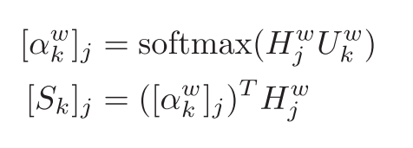
Method
HLW-LSTM:

Slide 8
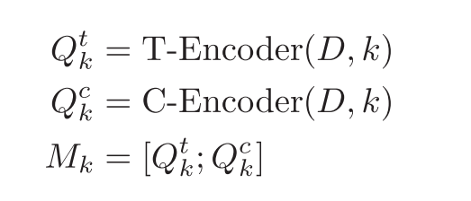
Method
Multi-Label Classification:

Slide 9
Dataset

Slide 10
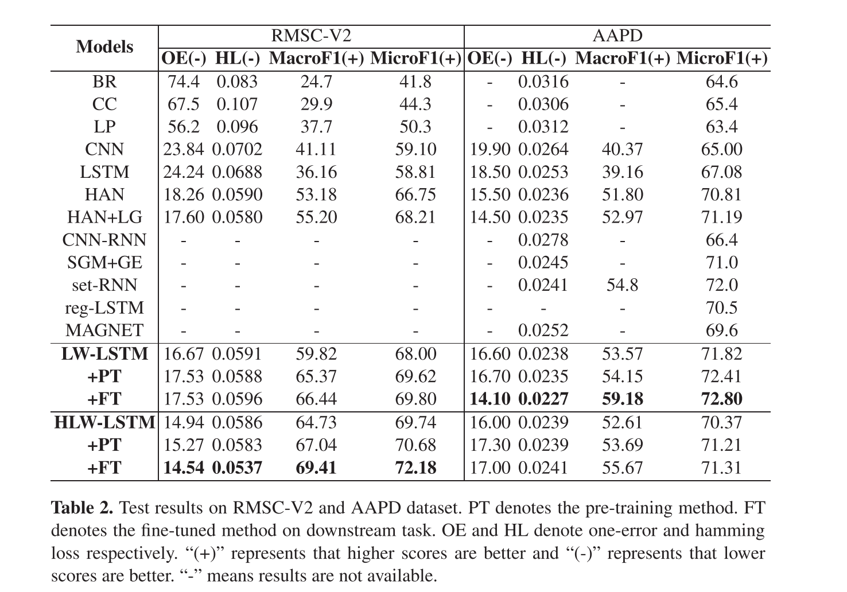
Experiment

Slide 11
Experiment

Slide 12
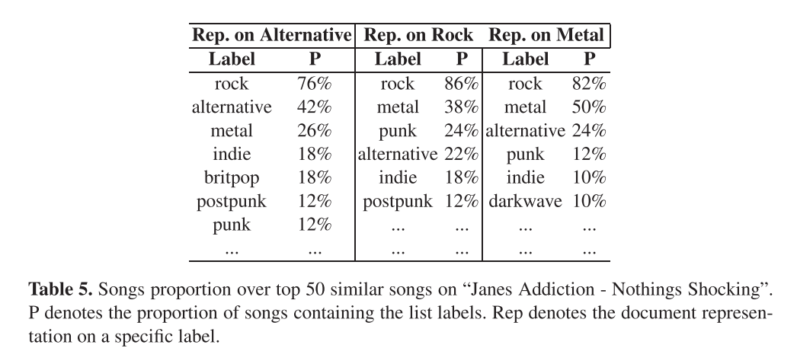
Experiment

Slide 13
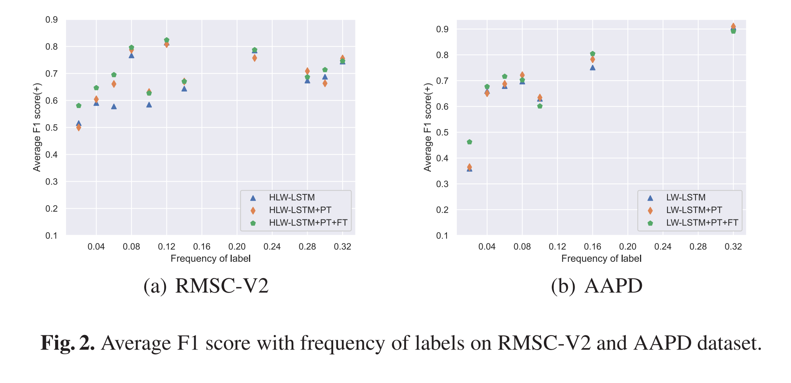
Experiment

Slide 14
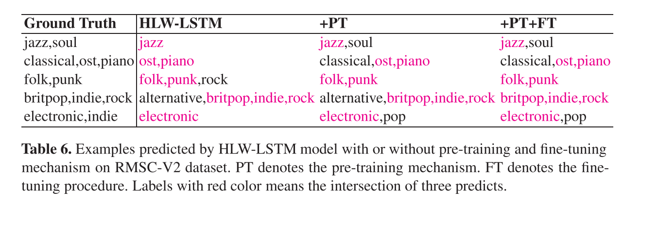
Experiment

Slide 15
Thanks

